Slide 1

SUSE Linux Enterprise Server Administration (Course 3037)
Chapter 3
Manage the Linux File System

Slide 2
Objectives
Select a Linux File System
Configure Linux File System Partitions
Configure a File System with Logical Volume Management (LVM)

Slide 3
Objectives (continued)
Configure and Manage a Linux File System
Set Up and Configure Disk Quotas
Back Up and Restore the File System

Slide 4
Select a Linux File System
Objectives
  Linux File Systems
  Linux File System Formats
  Linux File System Characteristics
  File System Journaling
  Additional File System Documentation

Slide 5
Linux File Systems
Traditional file systems
  ext2
  minix
  MS-DOS/VFAT
  HPFS (High Performance File System)
Journaling file systems
  ext3
  ReiserFS
  NTFS (New Technology File System)

Slide 6
Linux File Systems (continued)
Journaling file systems (continued)
  JFS
  XFS
  Verita’s VxFS
Virtual Filesystem Switch (VFS)
  Abstract level in the kernel
  Provides defined interfaces on the part of the processes
  Includes functions to open a file, write to a file, and read a file

Slide 7
Linux File Systems (continued)

Slide 8
Linux File System Formats
Data and administration information are kept separate
inode
  Each file is described by an inode
  It has a size of 128 bytes
  Contains file information including:
    Owner
    Access permissions
    Size
    Links to data blocks of the file

Slide 9
Linux File System Formats (continued)
ext2fs file system format
  Similar to traditional UNIX file system formats
  An inode must exist for each file or directory
  On average, each file should be 4 KB in size
  The space on a partition is divided into blocks
  Data is stored in a linear chain of blocks of equal size
  Boot sector is located at the beginning of this chain
    Contains static information about the file system
    Including where the kernel to load can be found

Slide 10
Linux File System Formats (continued)

Slide 11
Linux File System Formats (continued)
ReiserFS format
  Has only 1 fixed block size of 4096 bytes
  Small files are stored more efficiently
  inodes required are not generated when the file system is created
    But only when they are actually needed
  Access to files is quicker
    Uses balanced binary trees to organize data blocks

Slide 12
Linux File System Formats (continued)
Directories
  Inodes contain all administrative information for a file
    But not the filename
  Directories contain information on other files
    Number of the inode for the file and its name
  ls –i
    Displays inode assigned to a filename
  inodes are uniquely defined on one partition only
  Entry “.” is a link to the current directory
  Entry “..” is a link to the previous layer

Slide 13
Linux File System Formats (continued)

Slide 14
Linux File System Formats (continued)
Network File System Formats
  Network File System (NFS)
    Standard in the UNIX world
    Does not matter which file system format is used locally
    Provides its file systems in a defined format NFS clients can access
  Other network file system formats
    Server Message Block (SMB)
    Netware Core Protocol (NCP)

Slide 15
Linux File System Characteristics
Linux and UNIX file systems
  Start from a root (/) directory
  Include all other physical or network file systems under the root directory
  Filenames are case sensitive
  Long filenames are supported by native Linux file systems
  Linux also includes support for timestamps
    ctime
    mtime
    atime

Slide 16
Linux File System Characteristics (continued)
Linux file types
  Normal files
    Set of contiguous data addressed with one name
  Directories
    Special files containing information about other files
  Device files
    Hardware in a Linux system is represented by a device file
  Links
    References to files located at other points in the file system

Slide 17
Linux File System Characteristics (continued)
Linux file types
  Sockets
    Data exchange between two locally running processes can be implemented through the file system
  FIFOs
    Also known as named pipes
    Term used for files to exchange data between processes

Slide 18
Linux File System Characteristics (continued)
Linux file system directories
  File system is hierarchical
  Directories are defined by the Filesystem Hierarchy Standard (FHS)
    In the Linux Standard Base (LSB)
  FHS defines a two-layered hierarchy
    Directories in top layer
    Directories under /usr/

Slide 19
Linux File System Characteristics (continued)

Slide 20
File System Journaling
Journaling and file system transactions
  Metadata
    File information stored by the file system
  File system transactions
    Update the file (the data)
    Update the file metadata
  Corruption occurs when file data and metadata differ
  You do not need to check and repair journal-based file systems
  Journal-based file system keeps a record of all current transactions
    And updates the journal as transactions are completed

Slide 21
File System Journaling (continued)
ext2 and ext3 comparison
  ext2fs or ext2
    Linux standard file system
    After a crash, all files need to be checked
    Used for small partitions
  ext3fs
    Latest version of Linux standard file system
    Provides journaling functionality
    After a crash, only open files need to be checked
    You can journal file data and metadata
      Or simply the metadata
    Disadvantage: administrative information overhead

Slide 22
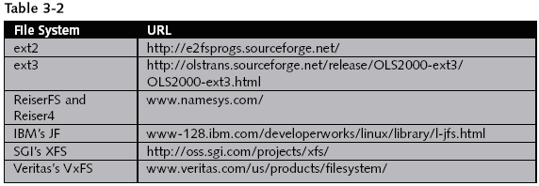
Additional File System Documentation

Slide 23
Configure Linux File System Partitions
Objectives
  Partition Types
  Linux Device and Partition Names
  Design Guidelines for Implementing Partitions
  Design Guidelines for Optimizing Partitions
  How to Manage Partitions with YaST

Slide 24
Partition Types
Primary partition
  Consists of a continuous range of cylinders
    Assigned to a particular operating system
Extended partitions
  Continuous ranges of disk cylinders
  Can be subdivided into logical partitions
Logical partitions
  Do not require entries in the partition table

Slide 25
Linux Device and Partition Names
Partitions naming convention
  Device name and partition number

Slide 26
Linux Device and Partition Names (continued)

Slide 27
Linux Device and Partition Names (continued)

Slide 28
Linux Device and Partition Names (continued)

Slide 29
Design Guidelines for Implementing Partitions
File system size
  Minimal system: 700 MB
  Minimal system with graphical interface: 1GB
  Default system: 1.5 GB
  Full installation: 2.5 GB
Disk space distribution
  Up to 4 GB
    One partition for swap and one for root partition
  4 GB or more
    Swap, root, /usr/, /opt/, and /var/

Slide 30
Design Guidelines for Implementing Partitions (continued)
Boot partition
  Should be located at the start of the disk
  Should be at least 8 MB or 1 cylinder
Software and /opt/
  Create a separate partition for /opt/
Additional partitions
  Entered in the file /etc/fstab
Executable files
  Specified with options noauto and user

Slide 31
Design Guidelines for Optimizing Partitions
Size of the swap partition
  256 MB is a reasonable value
Processor speed and main memory size
  Size of memory is more important than processor speed
  Linux creates dynamic buffers with hard disk data
    Linux uses techniques such as
      Read ahead
      Delayed write

Slide 32
Design Guidelines for Optimizing Partitions (continued)
Stand-alone computer guidelines
  See Table 3-6
File server guidelines
  Use SCSI devices if possible
  Optimize hard disk access
    For file servers in networks of more than 20 users
Computer server guidelines
  Large main memory
  Fast disk throughput for the swap partition

Slide 33
Design Guidelines for Optimizing Partitions (continued)

Slide 34
How to Manage Partitions with YaST
Create a partition
  Expert Partitioner
    Lets you manually modify the partitioning of your hard disk

Slide 35
How to Manage Partitions with YaST (continued)

Slide 36
How to Manage Partitions with YaST (continued)

Slide 37
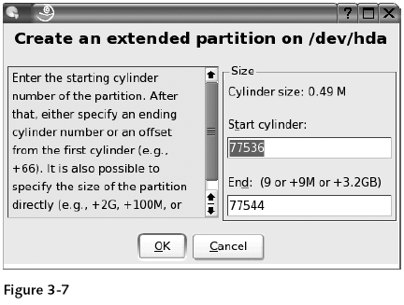
How to Manage Partitions with YaST (continued)

Slide 38
How to Manage Partitions with YaST (continued)
Edit a partition
  Expert Partitioner
    Lets you edit partition parameters
Resize a partition
  Expert Partitioner
    Lets you resize a partition

Slide 39
How to Manage Partitions with YaST (continued)

Slide 40
How to Manage Partitions with YaST (continued)

Slide 41
How to Manage Partitions with YaST (continued)

Slide 42
Exercise 3-1 Configure Partitions on Your Hard Drive
In this exercise, you do the following:
  Part I: Use YaST to Create a Partition and File System
  Part II: Manually Partition with fdisk

Slide 43
Configure a File System with Logical Volume Management (LVM)
Logical Volume Management
  Provides a higher-level view of the disk storage
  Gives you much more flexibility in allocating storage to applications and users
  You can resize and move logical volumes
    While partitions are still mounted and running
  Use LVM to manage logical volumes with names that make sense

Slide 44
LVM Components
Linux file system is basically inflexible
It is difficult to modify partitions on a running system
LVM provides a virtual pool of memory space
  Called a volume group
  From which logical volumes can be generated if needed
LVM lets you resize the physical media during operation
Physical volumes are combined to a super unit
  Referred to the volume group

Slide 45
LVM Components (continued)

Slide 46
LVM Features
Features
  You can combine several hard disks or partitions
  You can enlarge a logical volume when free space is exhausted
  You can add hard disks to the volume group in a running system
  You can add logical volumes in a running system
  You can use several hard disks with improved performance in the RAID 0 (striping) mode
  You can add up to 256 logical volumes
  The Snapshot feature enables consistent backups

Slide 47
How to Configure Logical Volumes with YaST
Steps
  Define the LVM partition (physical volume) on the hard drive
  Create the volume group and logical volumes

Slide 48
How to Configure Logical Volumes with YaST (continued)

Slide 49
How to Configure Logical Volumes with YaST (continued)

Slide 50
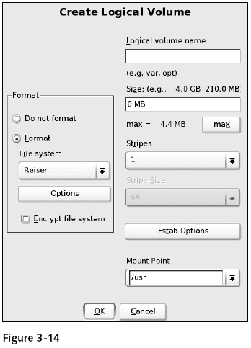
How to Configure Logical Volumes with YaST (continued)

Slide 51
Exercise 3-2 Create Logical Volumes
In this exercise, you do the following:
  Part I: Create LVM Volumes
  Part II: Resize a LVM Volume

Slide 52
Configure and Manage a Linux File System
Tasks involved
  Create a File System from YaST
  Create a File System from the Command Line
  Mount a File System
  Monitor and Check a File System
  Create a Boot, Rescue, or Module Disk

Slide 53
Create a File System from YaST
Steps
  Start YaST Expert Partitioner
  Select the partition to assign a file system
  Format the partition
  Select an available file system
  View available format options
  Encrypt all data saved to the partition
  Configure fstab options
  Enter mounting point
  Configure file system and mounting parameters
  Save changes

Slide 54
Create a File System from YaST (continued)

Slide 55
Create a File System from YaST (continued)

Slide 56
Create a File System from the Command Line
mkfs
  Creates file systems such as:
    ext2
    ext3
    MS-DOS
    MINIX
    XFS
    JFS
mkreiserfs
  Creates a Reiser file system

Slide 57
Create a File System from the Command Line (continued)

Slide 58
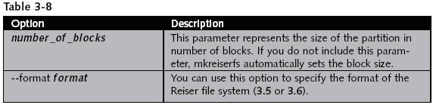
Create a File System from the Command Line (continued)

Slide 59
Mount a File System
Mount points
  Used by Linux to mount partitions in a folder in the file system
Directory /mnt/
  Used by default for mounting local and remote file systems
Devices are automatically mounted
  Using the defaults in /etc/fstab

Slide 60
Mount a File System (continued)

Slide 61
Mount a File System (continued)
Configuration files for mounting
  /etc/fstab file
    Contains one line with six fields for each mounted file system
  /etc/mstab file
    Lists the file systems currently mounted and their mount points
  /proc/mounts
    Lists all currently mounted partitions
    Used by the kernel

Slide 62
Mount a File System (continued)
How to view currently mounted file systems
  Use the command mount
How to mount a file system
  Use the command mount
  Syntax
    mount [-t file_system_type] [-o mount_options] device mount_point_directory
  Options include
    remount, rw, ro, sync, async, atime, notime, nodev, dev, noexec, exec, nosuid, suid, auto, noauto, user, nouser, and defaults

Slide 63
Mount a File System (continued)
How to mount a file system in more than one location
  Use the --bind parameter
  Syntax
    mount --bind old_directory new_directory
How to unmount a file system
  Use the umount command
  Use the device or the mount point

Slide 64
Exercise 3-3 Manage File Systems from the Command Line
In this exercise, you do the following:
  Part I: Create File Systems
  Part II: Customize the File Systems

Slide 65
Monitor and Check a File System
Check partition and file usage (df an du)
  df command
    Provides information on drives’ mount points in the file system
      And how much space they occupy
  du command
    Provides information on the space occupied by files and directories
Check open files (lsof)
  lsof command
    Lists open files

Slide 66
Monitor and Check a File System (continued)
Check PID usage (fuser)
  fuser command
    Displays the PIDs of processes using the specified files or file systems
Check /lost+found (ext2 and ext3 only)
  Directory /lost+found/
    Used to save files or file fragments that have “gone missing”
Check and repair any file system (fsck)
  fsck command
    Lets you check and optionally repair Linux file systems

Slide 67
Monitor and Check a File System (continued)

Slide 68
Monitor and Check a File System (continued)
Check and repair ext2/ext3 and ReiserFS
  e2fsck and reiserfsck commands
    Check the file system for
      A correct superblock
      Faulty data blocks
      Faulty allocation of data blocks
  With reiserfsck
    File system is subjected to a consistency check

Slide 69
Create a Boot, Rescue, or Module Disk
In case of a system failure
  Insert CD1 (or a DVD)
  Select rescue system
Use YaST
  To create a boot, rescue, or module disk

Slide 70
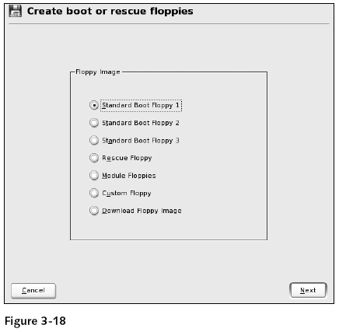
Create a Boot, Rescue, or Module Disk (continued)

Slide 71
Set Up and Configure Disk Quotas
Disk quota
  Lets you specify a specific amount of storage space
    For each user or group
  Support is included in SLES kernel
Tasks involved
  Prepare the File System
  Initialize the Quota System
  Configure and Manage User and Group Quotas
  Start and Activate the Quota Service

Slide 72
Set Up and Configure Disk Quotas (continued)

Slide 73
Prepare the File System
Indicate which file system’s quotas are to be activated
  By configuring entries in the file /etc/fstab
  Use keyword usrquota
    On the user level
  Use keyword grpquota
    For group quotas

Slide 74
Prepare the File System (continued)

Slide 75
Initialize the Quota System
quotacheck command
  Initializes the quota system
  Checks partition with quota keywords
  Stores quota values in files aquota.user and aquota.group

Slide 76
Configure and Manage User and Group Quotas
Configure soft and hard limits for blocks and inodes
  Use edquota –u user
    For setting up user quotas
  Use edquota –g group
    For setting up group quotas
Configure grace periods for blocks and inodes
  Use edquota –t
Copy user quotas
  Use edquota –p
Generate a quota report
  Use command repquota

Slide 77
Configure and Manage User and Group Quotas (continued)
Start and activate the quota service
  Appropriate links must be made in the run-level directories
    By entering insserv quota
      innserv quotad for NFS
  Start the quota service
    /etc/init.d/quota start
  Start or stop the quota service
    /usr/sbin/quotaon filesystem
    /usr/sbin/quotaoff filesystem

Slide 78
Exercise 3-4 Set Up and Configure Disk Quotas
In this exercise, you set up and configure disk quotas using the previous commands

Slide 79
Back Up and Restore the File System
Tasks involved
  Data Backup Strategies
  Back Up System Data with YaST
  Restore System Data with YaST
  Data Backup Command Line Tools

Slide 80
Data Backup Strategies
Backup media
  Administrators normally use tape drives
  Other media include
    Writable CDs or DVDs
    Removable hard drives
    Magnetic-Optical (MO) drives
  Storage Area Networks (SANs)
    Networks that back up data from different computers
Backup requirements
  Reconstruct lost data as quickly as possible
  Amount of data should be kept as small as possible

Slide 81
Data Backup Strategies (continued)
Backup frequency
  Highly sensitive data
    Complete daily backup is unavoidable
  Less sensitive data
    Perform a weekly backup
Tape availability
  Keep two sets of tapes
    One for less sensitive data
    One for daily backup of sensitive data

Slide 82
Data Backup Strategies (continued)
Tape storage
  Store backup tapes separately from the server
    Prevents backups from being lost in a disaster

Slide 83
Back Up System Data with YaST
Steps
  Start YaST System Backup module
  Create a profile
  Enter a name for the profile
  Enter filename for the backup file
  Save backup file to a local directory
  Create a backup file
  Select backup options
  Enter a description for the backup file (optional)
  Use MD5 sum checking

Slide 84
Back Up System Data with YaST (continued)

Slide 85
Back Up System Data with YaST (continued)

Slide 86
Back Up System Data with YaST (continued)

Slide 87
Back Up System Data with YaST (continued)
Steps
  Configure advanced options
  Add an item to the exclusion list
  Edit or remove an item from the list
  Start the backup

Slide 88
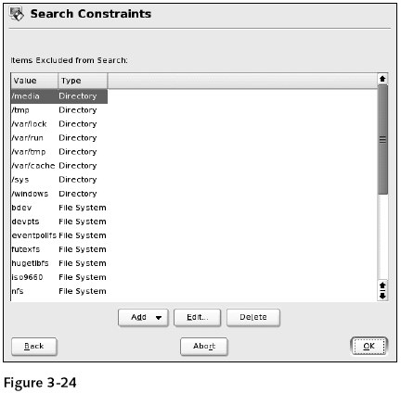
Back Up System Data with YaST (continued)

Slide 89
Restore System Data with YaST
Steps
  Start YaST Restore system module
  Select backup file to be restored
  View the archive contents
  Configure restore options
  Select files to be restored
  Restore RPM database (optional)
  Restore files
  Save summary (optional)

Slide 90
Restore System Data with YaST (continued)

Slide 91
Restore System Data with YaST (continued)

Slide 92
Restore System Data with YaST (continued)

Slide 93
Data Backup Command Line Tools
tar (tape archiver)
  Most commonly used tool for data backup
  Archives files in a special format directly on a corresponding medium
rsync (remote synchronization)
  Creates copies of complete directories across a network
    To a different computer
dd
  You can convert and copy files byte-wise

Slide 94
Data Backup Command Line Tools (continued)
mt command
  Allows you to work with magnetic tapes
    Position tapes
    Switch compression on or off
    Query the status of the tape
cron service
  Allows you to automate backup from the command line

Slide 95
Exercise 3-5 Back Up System Files on Your Server
In this exercise, you use the utilities gzip/gunzip, bzip2, and tar as archiving tools
  To back up files and user and group files

Slide 96
Summary
File systems available for Linux
  ext2, minix, MS-DOS/VFAT, and HPFS
  ext3, ReiserFS, NTFS, JFS, XFS, and VxFS
Each file system contains a superblock
  Stores the structure of the file system
Linux file system is arranged hierarchically
  Using directories described by the FHS
Types of files
  Normal files, directories, device files, links, sockets, and FIFOs

Slide 97
Summary (continued)
Journaling file systems
  Maintain a transaction log
    Used to track changes to files and speed up the checking of file system errors
File systems on a hard disk must reside in a partition
Carefully plan number and size of partitions
Create, manage, check, and mount file systems and partitions using
  YaST
  mkfs, mkreiserfs, fsck, e2fsck, reiserfsck, mount, and umount

Slide 98
Summary (continued)
/etc/fstab file
  Used by Linux to automatically mount partitions
Logical Volume Management (LVM)
  Flexible file systems for use in SLES
Disk quotas
  Restrict the use of the file system
Back up file system data
  To prevent loss of data in case of a system crash

